Slide 1

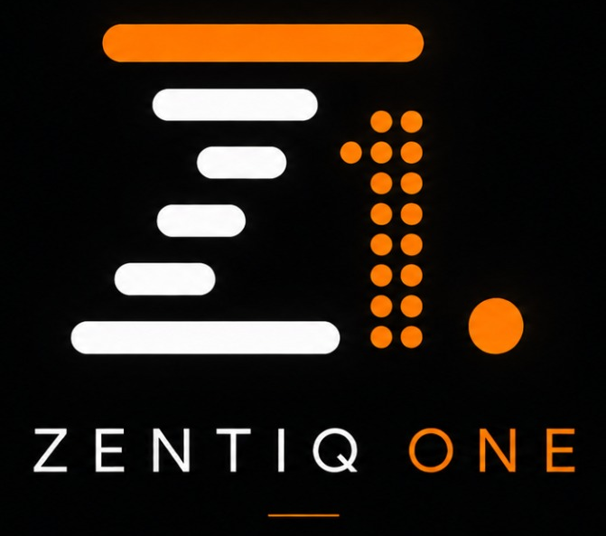
RazorSharpFocus
Intelligence Private Limited
FINTECH CAPABILITY PROFILE
Engineering Fintech
From Idea to Live Transactions
RazorSharpFocus builds fintech products end to end — powered by ZentiqOne, our core payments engineering practice.
Bank Tie-Ups
Payments
Product Engineering
Aggregator Integration
Compliance
Certification
RazorSharpFocus Intelligence Private Limited
Engineering Intelligent Business Execution
01 / 11

Slide 2
WHO WE ARE
Your End-to-End Fintech Partner
One team for product build, bank tie-ups, compliance and go-live.
RazorSharpFocus is a fintech engineering company. We help startups and enterprises build payment and lending products, connect them to banks and payment aggregators, guide them through the right licences and certifications, and stay with them after launch. ZentiqOne is our core payments engineering service — the platform behind everything we deliver.
Build
Connect
Certify
Launch
Scale
Consult
Support
BUILD · CONNECT · CERTIFY · GO LIVE
What We Build
Who We Connect
Proven in Production
Payment gateways, wallets, UPI and BBPS journeys, collections, payouts and lending platforms.
Sponsor banks, payment aggregators and processors — introduced, integrated and certified.
Startups we built for are live today and transacting commercially at scale.
RazorSharpFocus Intelligence Private Limited
Engineering Intelligent Business Execution
02 / 11

Slide 3
WHY IT MATTERS
Why Fintech Founders Need One Partner
Six reasons launching a fintech alone takes longer and costs more.
Complex Rails
Bank Dependencies
Compliance Load
UPI, cards, wallets and settlement each carry their own engineering depth.
Nothing moves without a sponsor bank and an aggregator relationship in place.
Licences, audits and certifications decide whether you can go live at all.
Slow In-House Builds
Integration Sprawl
Scale from Day One
Hiring a payments team costs 6 to 12 months before a single transaction.
Multiple vendors mean hand-offs, gaps and no one accountable for go-live.
Volume, uptime and reconciliation are tested the moment you launch.
WHY IT MATTERS
Founders do not need six vendors. They need one partner accountable from build to live transactions.
RazorSharpFocus Intelligence Private Limited
Engineering Intelligent Business Execution
03 / 11

Slide 4
BANKING & PAYMENTS EXPERTISE
Every Rail, Every Journey, One Partner
Hands-on expertise across the full banking and payments stack.
MAJOR CAPABILITIES
Digital & API Banking
Payments & Acquiring
Settlement & Risk
Digital banking, API banking and open banking journeys for retail and business customers.
Gateway, switch, orchestration and merchant acquiring across UPI, QR, payouts and collections.
Reconciliation, settlement, disputes and fraud management engineered for scale.
EXPECTED OUTCOMES
Higher Success Rates
Faster Time to Market
Lower Operational Load
Fewer failed payments, fewer complaints
New rails launched in weeks
Reconciliation effort falls sharply
WHY IT MATTERS
Payments are the most frequent touchpoint an institution has with its customers — reliability here shapes trust everywhere else.
RazorSharpFocus Intelligence Private Limited
Engineering Intelligent Business Execution
04 / 11

Slide 5
OUR CORE SERVICE · ZENTIQONE
ZentiqOne: Our Core Payments Engineering Service
ZentiqOne is the fintech engineering core of RazorSharpFocus. It acts as your outsourced payments team, building the infrastructure that moves money for banks, fintechs, NBFCs and aggregators.
CORE SERVICES
Payment Platform Development
Merchant Enablement
Banking Solutions & Architecture
Payment gateways, digital wallets, UPI and BBPS systems, and collection or disbursement workflows.
Onboarding merchants at scale — gateway selection, compliance, integration and go-live certification.
API integration, payment orchestration and standards such as ISO 8583, ISO 20022 and escrow structures.
WHAT YOU GAIN
Weeks, Not Quarters
Predictable Cost
Compliance Ready
Launch instead of building for 6–12 months
Service fees in place of a hired build team
Bank and regulator audits built in
WHY IT MATTERS
ZentiqOne takes the heavy backend engineering off your roadmap, so your team can focus on product, distribution and growth.
RazorSharpFocus Intelligence Private Limited
Engineering Intelligent Business Execution
05 / 11

Slide 6
ZENTIQONE · CORE ENGINEERING
Engineering the Rails That Move Money
The regulated infrastructure beneath every transaction — designed, built and certified by ZentiqOne.
CORE ENGINEERING & ARCHITECTURE
Payment Gateways
Digital Wallets
UPI & BBPS Integrations
Custom gateways and unified orchestration layers that route transactions efficiently.
Secure closed-loop, semi-closed and open-loop wallet infrastructures.
Ready-to-scale India Stack architectures across UPI and Bharat Bill Payment System.
ENGINEERED IN
Financial Messaging
Settlement & Escrow
Scale by Default
Deep ISO 8583 and ISO 20022 compliance
Reconciliation and fund-flow structures
Cloud-native, API-first, high volume
WHY IT MATTERS
Payment infrastructure is unforgiving — it is engineered once, correctly, or it is paid for repeatedly in failures and audits.
RazorSharpFocus Intelligence Private Limited
Engineering Intelligent Business Execution
06 / 11

Slide 7
BANK TIE-UPS · COMPLIANCE · CERTIFICATION
From Bank Tie-Up to Go-Live Certification
We connect you to the right sponsor bank and aggregator, then take you through compliance and certification to launch.
TIE-UPS & MERCHANT ENABLEMENT
Rapid Onboarding
Bank & Aggregator Tie-Ups
Compliance & Certification
Automated workflows to sign up, verify and activate merchants at scale.
The right sponsor bank, aggregator and processor for your model — introduced and integrated.
Bank compliance, security audits and final go-live certifications, guided end to end.
READINESS CHECKLIST
Partner vs Build
Regulatory Licensing
Sponsor Bank
Weeks with ZentiqOne, 6–12+ months in-house
PA/PG, PPI or NBFC status — or operate as a TSP
Only licensed banks hold and settle funds
WHY IT MATTERS
We build the pipes and clear the certifications — you secure the licence and the sponsor bank, and go live with confidence.
RazorSharpFocus Intelligence Private Limited
Engineering Intelligent Business Execution
07 / 11

Slide 8
HOW WE DELIVER
From Idea to Live Transactions
A disciplined, eight-stage path from first conversation to money moving in production.
1
2
3
4
5
6
7
8
Consult
Design
Build
Integrate
Tie-Up
Certify
Go Live
Scale & Support
WHY IT MATTERS
Every stage has named owners and clear exit criteria — which is why our launches stay predictable.
Eight disciplined stages. One accountable fintech partner.
RazorSharpFocus Intelligence Private Limited
Engineering Intelligent Business Execution
08 / 11

Slide 9
OUR TRACK RECORD
Startups We Built Are Live and Transacting
Why fintech founders choose RazorSharpFocus and stay with us after launch.
Proven Launches
Payments Depth
Compliance Confidence
Multiple startups we engineered are running today and transacting commercially.
Decades of hands-on banking and payments engineering, not learned on your project.
Audits and certifications cleared with banks and regulators, repeatedly.
Faster to Market
Single Accountability
Support After Launch
Weeks to launch instead of 6 to 12 months of in-house build.
One partner for build, bank tie-up, certification and go-live.
Dedicated pods that run and evolve your platform as volumes grow.
WHY IT MATTERS
Founders stay with RazorSharpFocus because our accountability does not end at go-live.
RazorSharpFocus Intelligence Private Limited
Engineering Intelligent Business Execution
09 / 11

Slide 10

LEADERSHIP
Led by an Engineer Who Has Run Payment Systems at Scale
Founder-led, payments-deep and accountable at the top.
Founder
25+ Years of Experience
The Vision
Amit Kumar Tyagi, Founder
RazorSharpFocus Intelligence Pvt. Ltd.
linkedin.com/in/amit-kumar-tyagi
Two and a half decades across banking, payments and fintech platform engineering.
To be the engineering partner every fintech founder can depend on from idea to scale.
Hands-On Leadership
Engineering Philosophy
People & Craft
Leadership stays close to delivery — every major engagement has executive ownership.
Business outcomes first, engineering rigor always, shortcuts never.
Investing in teams, mentorship and craftsmanship as a competitive advantage.
OUR COMMITMENT
Leadership at RazorSharpFocus is measured by what our clients successfully run in production.
RazorSharpFocus Intelligence Private Limited
Engineering Intelligent Business Execution
10 / 11

Slide 11
CONTACT
Let's Engineer What Comes Next
Build. Connect. Certify. Go live — engineered end to end.
RAZORSHARPFOCUS INTELLIGENCE PRIVATE LIMITED
For fintech product, payments or certification enquiries, reach RazorSharpFocus
WEBSITE
EMAIL
PHONE
www.razorsharpfocus.com
amit@razorsharpfocus.com
+91 8750908771
linkedin.com/company/razorsharpfocus​
​
RazorSharpFocus Intelligence Private Limited
Engineering Intelligent Business Execution
11 / 11

